Slide 1
SAP BTP Architect Training
Day 7
Anubhav Oberoy
www.AnubhavTrainings.com
Follow excellence with sheer passion

Slide 2


DISCLAIMER
The training content and delivery of this presentation is confidential, and cannot be recorded, or copied and distributed to any third party, without the written consent of Anubhav Trainings

Slide 3
Agenda – Day 7
01
04
Application Security
Application Router
02
05
Identity Provider
Deployment
03
06
CI/CD pipeline with SAP BTP CTS
XSUAA Service

Slide 4
Authentication v/s Authorization
Authentication – It ensures that is our user a valid user? Has he/she entered valid credentials to login to our app. It is enforced by a login screen. This login screen can also come from IDP like SSO, LDAP, Social integration.
Authorization – Once user is authentication, then the authorization comes into play. It ensures, is our user allowed to do certain activities inside app. What is the level of access. E.g. create, update, delete, approve, view.
SAP BTP cf environment has a special component called XSUAA –
XS – eXtended Services
UAA – User Account and Authorization
This is an in-built component inside of CF
It is responsible to control the user account and authorization
It manages our application security
In CF we use modular approach to address security
As a developer we need to decide what roles and level of security we need in our app. Example, we need to secure odata resource /Anubhav.svc
Usually we define Viewer, Editor
We need to define our scope and role templates inside a special file called xs-security.json file
XSUAA Communicates to the IDP – Identity Provider
Issues JWT (JSON web Token) to cloud foundry router which let user access the app based on permission.
Scope
(Role)
* *
Role Template
* *
Role Collection

Slide 5

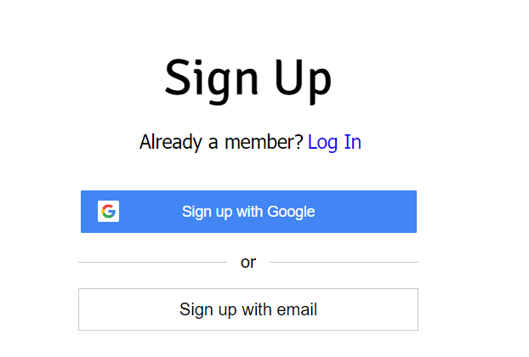

IDP – Identity Provider
An identity provider is a software or group of software which stores all the user credentials and their scopes (roles) in itself. This will centralize the user management in company and simplify the login process to different apps. This way user do not need to remember multiple passwords to multiple apps.
Portal
Launchpad
Dedicated SRM
SSO
SAP Server
GSuite
LDAP
User/email/password
Single source of truth
Trust relation
Scope- clerk, manager, ceo
Outlook
Our cloud app
xsuaa
XSUAA

Slide 6
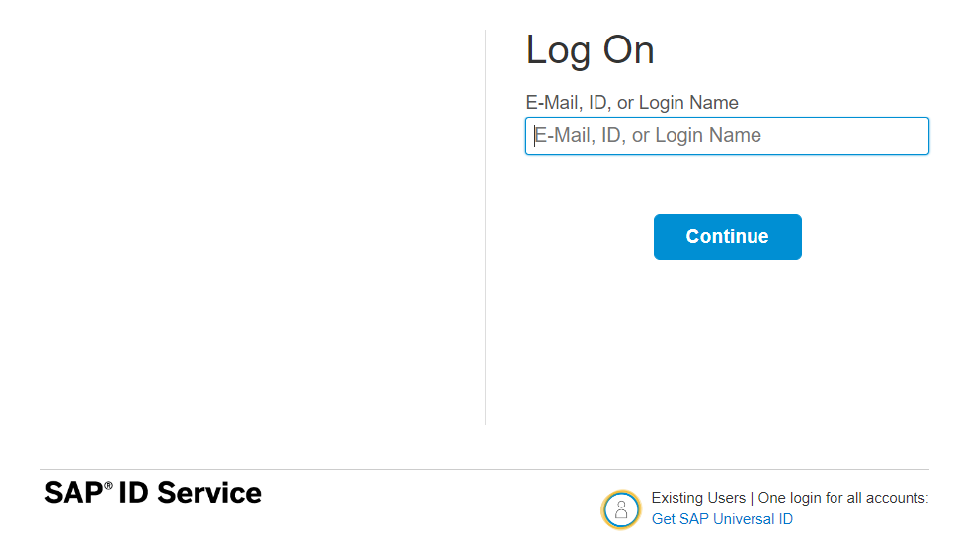
How it works behind scenes
xs-security.json contains information which we need to register to define what are all permissions required in our app
code
JWT
App
Browser
postman
ourxsuaa
trust
JWT
XSUAA
Scope
SAML
trust
IdP

Slide 7

Hands-on Add Security and Test Microservice
cds add xsuaa

Slide 8
Testing the Microservice from postman
After the deployment, we open the postman tool and try to access resource with URL /vendor url, it gives unauthenticated.
We need to obtain access token so we went to authorization table and added the OAuth2.0 option and provided
Properties | Value
Token Name | BTPJWTToken
Grant Type | Password credentials
Access Token URL | Service key of xsuaa – url, append /oauth/token
Client Id | Service key – client_id
Client Secret | Service key – client_secret
Username | Our BTP account user id
Password | Our BTP account password
3. Call get token and choose use token button once token was fetched.
4. Again make get request for /vendor, and we should get response.
5. If we try /vendor/, it will not work because, we are looking for Role.
6. Went to BTP subaccount and created a Role collection, added the role template and assign same to our user
7. Again get the token and try to access end point for OData, this time it works.

Slide 9
Challenges in Current Approach
Did you notice, that we need to first pass lots of technical details from service key
Pass all the info in correct manner to postman to obtain token
Once the token expired, we need to reobtain again and again
Our end user do not know all this. Automate the XSUAA JWT token processing.
In our app, we will have multiple microservices, like java, sap ui5, node app, xsuaa…
Each service produce one end point e.g. /vendors, /index.html, /customers, they all logically belongs to same app. Will you give 3 url to our user to access these apps?
These microservices also needs to communicate with each other. Provided we give a single end point to access our entire app to end user.
We want to complete redirect mechanism to let user go to login screen, authenticate on IDP and exchange of all the tokens should be seamless behind the scenes.
We need a single entry point for entire app, forwardAuth tokens should be done automatic.
url
Application router
(Provide single entry point, exchange auth token,
Communicate between microservices, like a facade)
xsuaa
Java
/Anubhav.svc
UI5 App
/index.html
Node
/customer

Slide 10
Introduction to App Router
It is a Node JS Application
It is used to automate the process of authentication, authorization with XSUAA to do token exchange
It sits in the middle of IDP and XSUAA, it will redirect the request to our microservice to xsuaa, and eventually to idp
IDP sends the login screen to the user, user authenticates, which is taken to XSUAA, XSUAA issues JWT Token, this JWT token is presented to api end points
App Router takes the JWT token from XSUAA and gives it to our microservices and even exchange this token to multiple microservices inside
It Serves as a single entry point for the entire app.
To tell app router about our multiple microservices so that it can re-direct, we need to create a configuration file named as xs-app.json which contains the details.

Slide 11



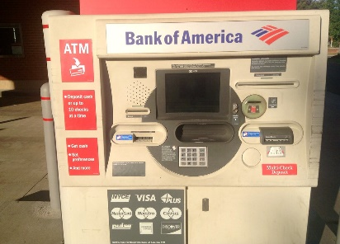
Real World Example
Customer
1
5
4
2
Loan
Credit Card
6
Validate, trust
Deposit
Draft/Cheque
3
FD
*******
7
Locker
This Photo by Unknown Author is licensed under CC BY

Slide 12
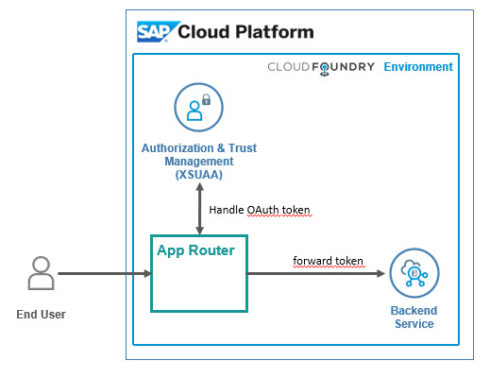
Hands on: App Router
Solution
https://github.com/soyuztechnologies/BTP_Architect_Training/blob/master/Day%203/04approuter.zip

Slide 13
Hands on : Deploy Application to BTP
First add the mta.yaml file, MTA – multi-target application which is an advance version of manifest.yml file which we used in past.
We use SAP provided CLI for MTA, this is pre-installed in BAS, tool is called mbt
First we run command cds add mta
We will add our UI module to the mta.yaml file manually, copy the srv entry and add the ui module.
- name: mycapapp-ui
type: nodejs
path: app
parameters:
buildpack: nodejs_buildpack
build-parameters:
builder: npm-ci
requires:
- name: srv-api
Inside the app folder, add the package json using npm init and add the app router module npm install @sap/approuter.
Add the start script "start": "node node_modules/@sap/approuter/approuter.js"
Add the xs-app.json, provide the routes and the end points
Open MTA editor and configure srv-api destination
Right click on mta.yaml file and choose build mta archieve this will create a mtar file for us

Slide 14
Adapt MTA.yml for UI deployment
Solution:

Slide 15
Hands on – Adding Security
Created a new resource in mta.yaml file for xs-uaa backing service with following properties
name == cappo-xsuaa
service == xsuaa
service-plan == application
path == ./xs-security.json
Add the dependency of this newly created xs-uaa service to our microservices in require section
Create the xs-security.json file from sap btp documentation and adapt file to have 2 roles – Viewer and the Admin role. The viewer role also have an attribute called bank name which will be for row level security.
Add 3 node modules which will help in security configuration for our app
npm install passport ; npm install @sap/xssec ; npm install @sap/xsenv
5. We need to inform app router to contact xsuaa to mandate the use of JWT token. In xs-app.json file
Change authenticationMethod : route and add "authenticationType": "xsuaa"
6. We need to secure our service resources to only allow authenticated user, hence we need to add an annotation requires: 'authenticated-user’
We need to tell system that if we run app locally (development environment) in BAS tool, use mock strategy for testing security. After deployment to CF (production environment) we use JWT strategy.

Slide 16
Security Profile
Additionally we configure demo local users for testing purpose. Under cds → requires section inside package.json file we add the strategy
"auth":{
"[production]":{
"strategy": "JWT"
},
"[development]":{
"strategy": "mock",
"users": {
}
}
}
8. Now we can test our app using cds watch --profile hybrid

Slide 17
CEO
US Manager
Anubhav
Ananya
All Employee
Who are from USA
All Employee
Name | BankName
A | X
B | X
C | Y
D | Y
E | Z
F | X
G | Y

Slide 18
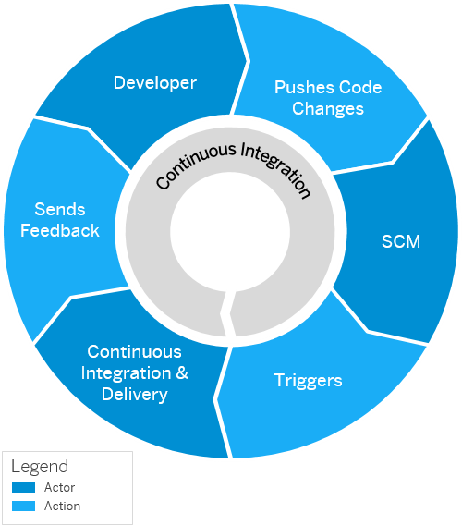
Continuous Integration and Delivery (CI/CD)
Configure and run predefined continuous integration and delivery (CI/CD) pipelines that automatically build, test, and deploy your code changes to speed up your development and delivery cycles.
Continuous integration (CI) describes a software development process, in which various team members integrate their contributions frequently into a single main line. Before each integration, the changes are verified through builds and automated testing. Thereby, you can detect errors as quickly as possible and prevent integration problems before completing the development.
The continuous delivery (CD) concept expands on the one of continuous integration. It adds the aspect that any change that has successfully passed the tests is immediately ready to be deployed to production, both from a technical and a qualitative point of view.

Slide 19
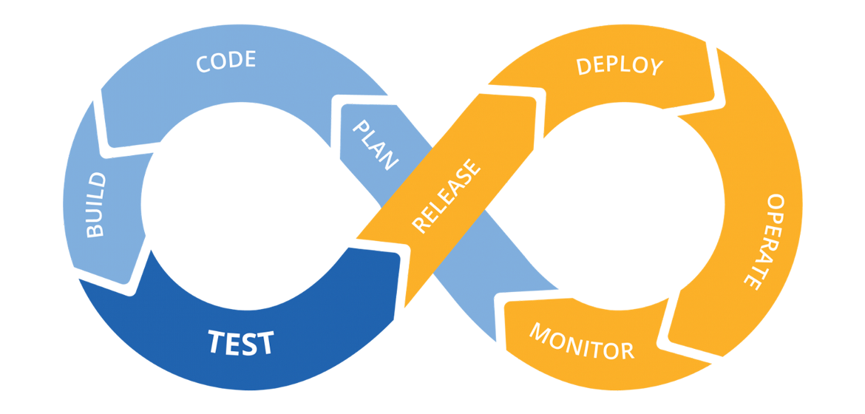
Hands on: Continuous Integration

Slide 20
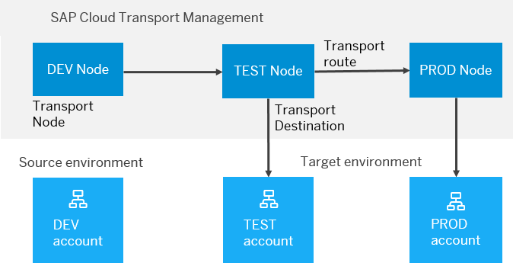
BTP Cloud Transport Management
SAP Cloud Transport Management service lets you manage software deliverables between accounts of different environments (such as Neo and Cloud Foundry), by transporting them across various runtimes. This includes application artifacts as well as their respective application-specific content.
SAP Cloud Transport Management service adds transparency to the audit trail of changes so that you get information about who performed which changes in your production environment, and when they did it. At the same time, the service enables a separation of concerns: For example, a developer of an application or of SAP Cloud content artifacts can trigger the transport of changes in a development subaccount, while the resulting import into the test, and production subaccount is handled by a central operations team.

Slide 21
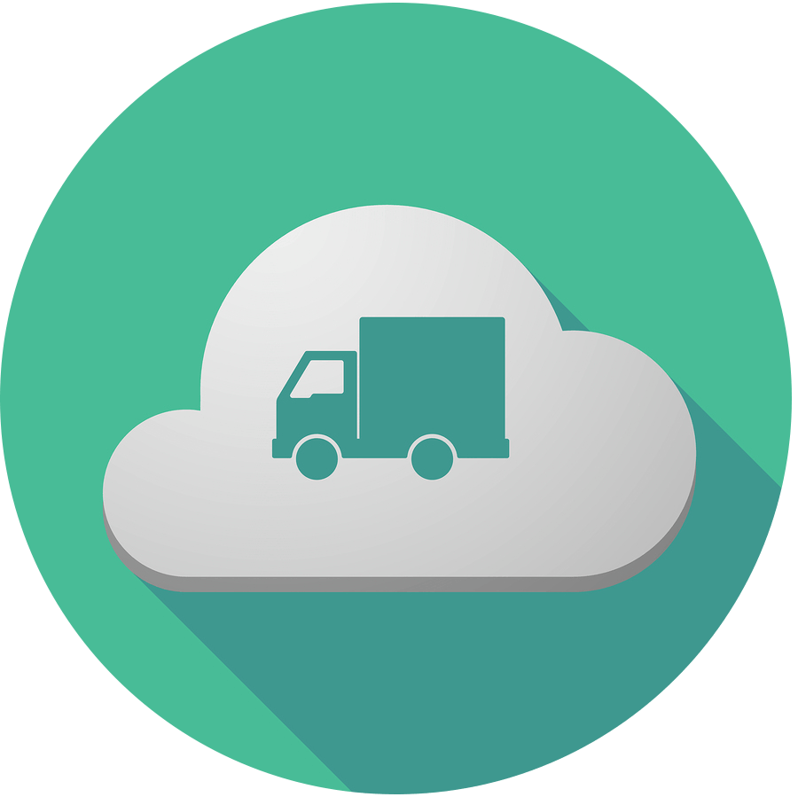
Hands on SAP BTP Cloud Transport

Slide 30

What We Did
Let’s Summarize

Slide 31

www.anubhavtrainings.com
Thank You
End of Day 7

Slide 32


We’re committed to empower you to be
#FutureReady
through powerful training solutions.
We build the workforce of the future.
270+
Corporate Clients
70,000+
Learners Trained
27000+
Learners Placed
FREE WEBINARS
Sign up for free webinars with industry experts every fortnight!
Enroll Now!
Contact us today!
https://anubhavtrainings.com

